Slide 1


Walmart Sales Data Analysis
ABDUL BASITH J
This Photo by Unknown Author is licensed under CC BY-SA
This Photo by Unknown Author is licensed under CC BY-SA

Slide 2
Understanding Sales Performance and Customer Behavior
Objective: Explore Walmart's sales data to gain insights into top-performing branches, product lines, sales trends, and customer behavior.
Goal: Improve and optimize sales strategies by understanding factors affecting sales across different branches and product lines.

Slide 3
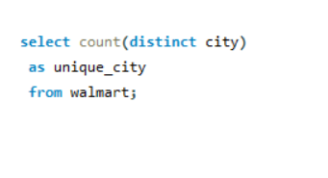
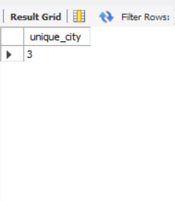
How many unique cities does the data have?

Slide 4
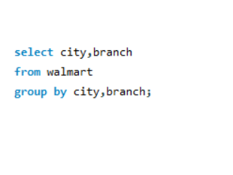
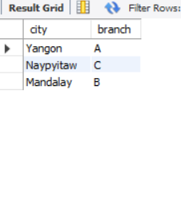
In which city is each branch?

Slide 5
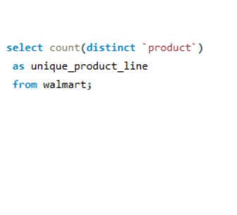
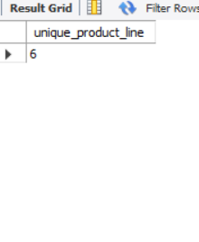
How many unique product lines does the data have?

Slide 6
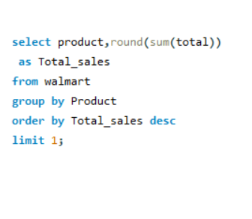
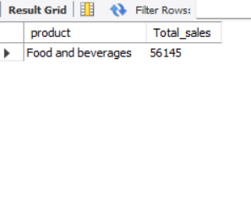
What is the most selling product line

Slide 7
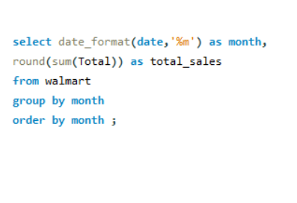
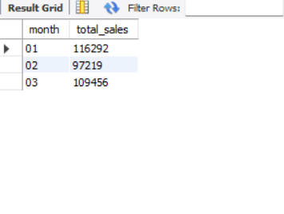
What is the total revenue by month

Slide 8
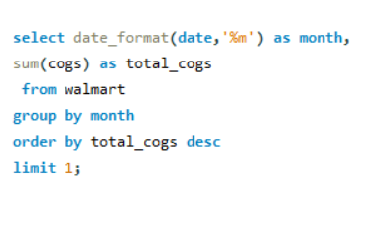
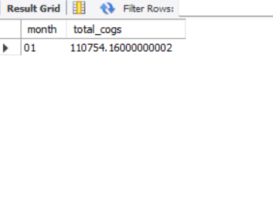
What month had the largest COGS?

Slide 9
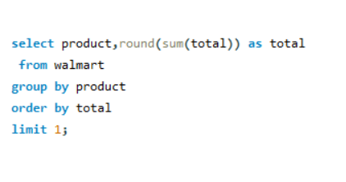
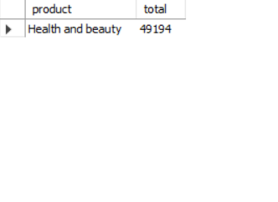
What product line had the largest revenue?

Slide 10
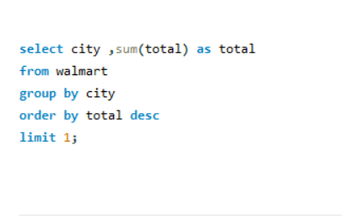
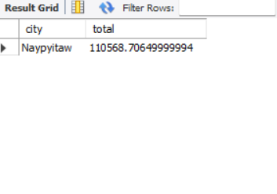
What is the city with the largest revenue?

Slide 11
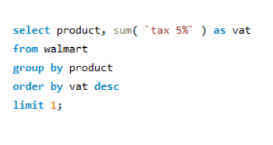
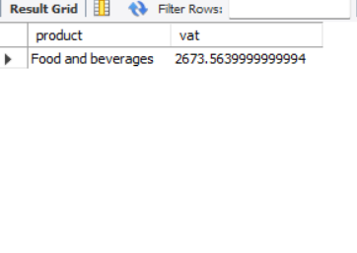
What product line had the largest VAT?

Slide 12
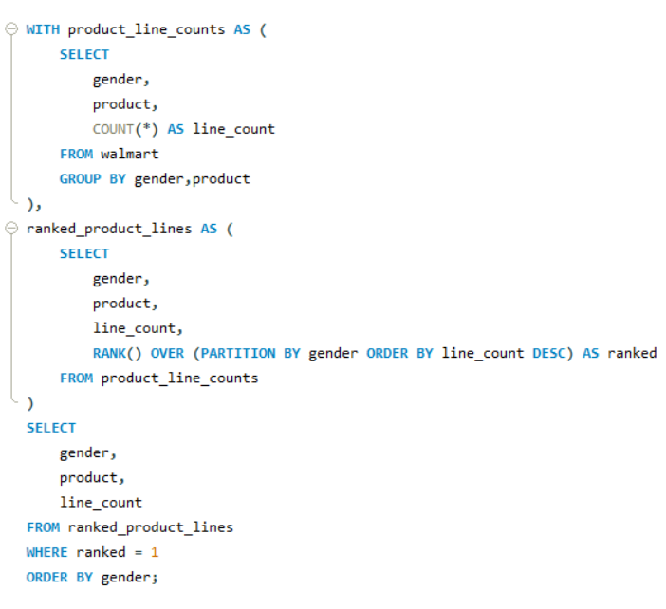
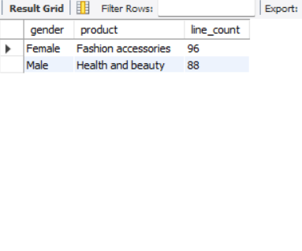
What is the most common product line by gender?

Slide 13
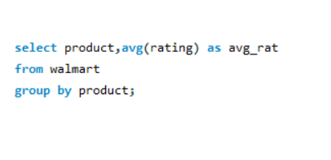
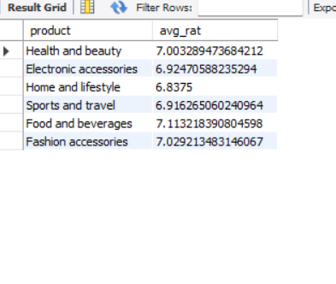
What is the average rating of each product line

Slide 14
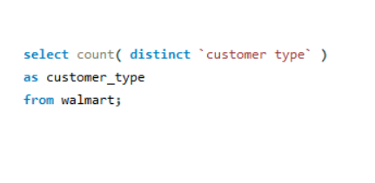
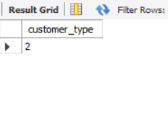
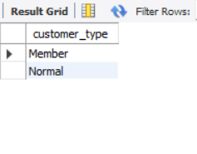
How many unique customer types does the data have

Slide 15
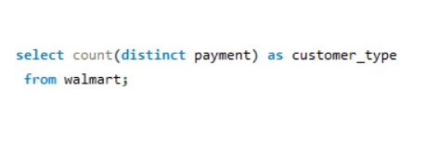
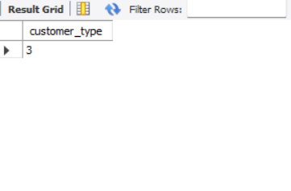
How many unique payment methods does the data have

Slide 16
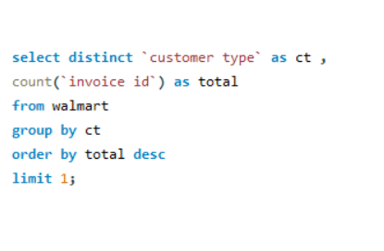
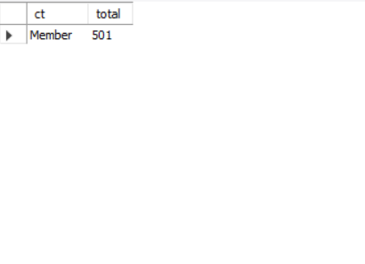
Which customer type buys the most?

Slide 17
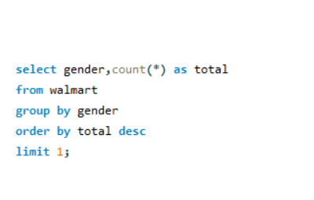
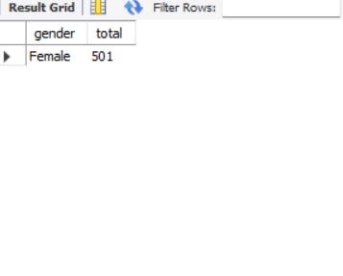
What is the gender of most of the customers?

Slide 18
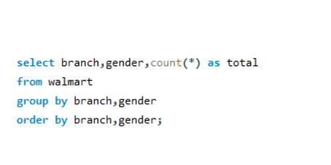
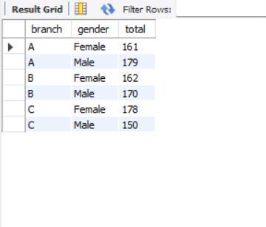
What is the gender distribution per branch

Slide 19
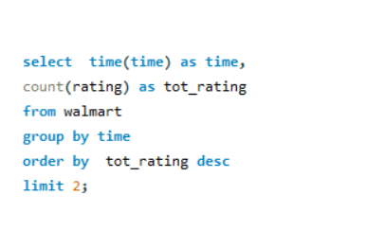
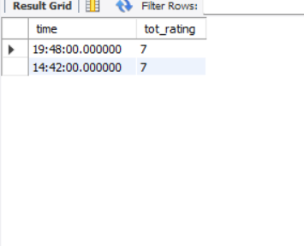
Which time of the day do customers give most ratings

Slide 20
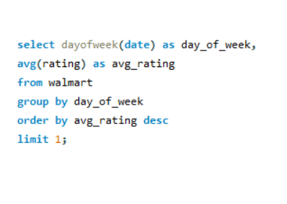
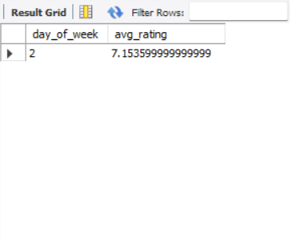
Which day fo the week has the best avg ratings

Slide 21
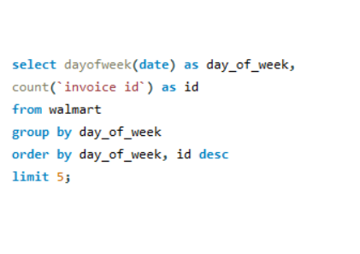
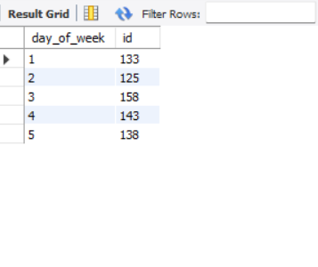
Number of sales made in each time of the day per weekday

Slide 22
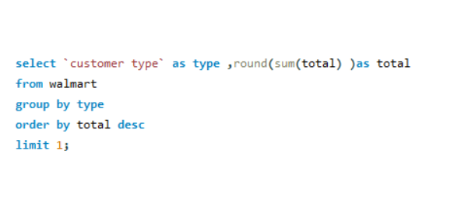
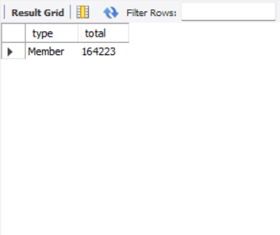
Which of the customer types brings the most revenue

Slide 23
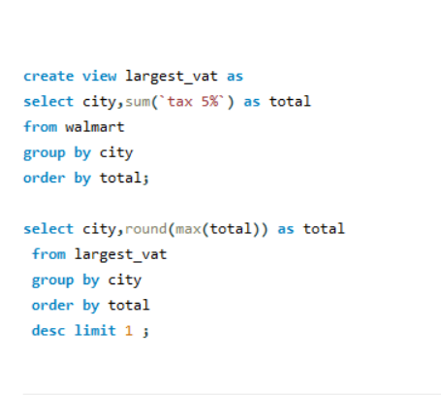
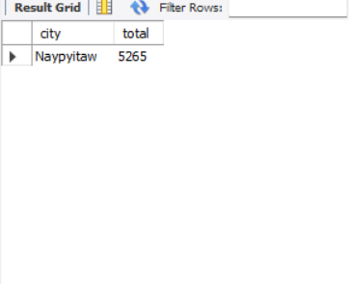
Which city has the largest tax/VAT percent?

Slide 24
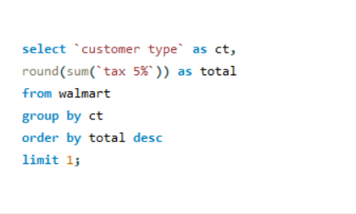
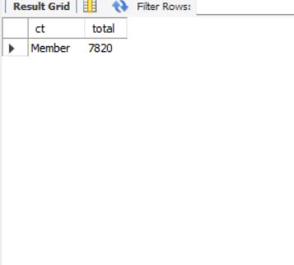
Which customer type pays the most in VAT

Slide 25
CONCULUSION:
By implementing these recommendations, Walmart can improve sales performance, enhance customer satisfaction, and increase revenue. Our analysis demonstrates the power of data-driven decision-making in driving business success.
Thank you for your attention, and we welcome any questions or further discussion on our analysis!

